Slide 1

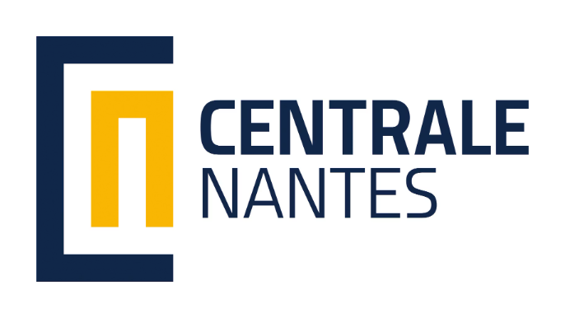
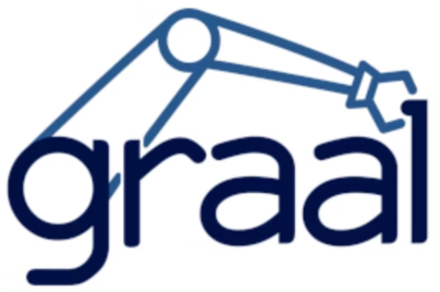
Aggressive Maneuver Planning and Control of a Multi-UAV and Payload System after a Failure
Master Thesis Defense
Presented by: Alvin Isac PREMSUNDER
14 October 2025
Supervisors: Prof. Marco Baglietto, Prof. Olivier Kermorgant, Dr. Andrea Delbene
UNIVERSITÉ DE GENOVA | ÉCOLE CENTRALE DE NANTES | GRAAL
Notes:
“Good morning everyone, and thank you for being here. My name is Alvin Isac Premsunder, and today I’ll be presenting my Master’s thesis defense titled ‘Aggressive Maneuver Planning and Control of a Multi-UAV and Payload System after a Failure.’ This work was carried out as part of a joint program between the University of Genova and École Centrale de Nantes, in collaboration with the GRAAL research group. I was guided by my supervisors — Professor Marco Baglietto, Professor Olivier Kermorgant, and Dr. Andrea Delbene. I’ll begin by giving you an overview of the motivation behind the work, the problem we addressed, the control approach we developed, and the key results we obtained.”

Slide 2
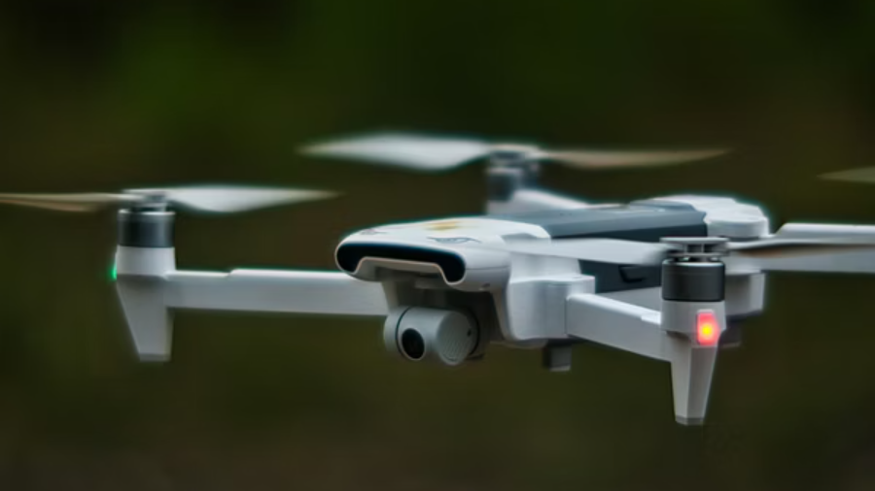
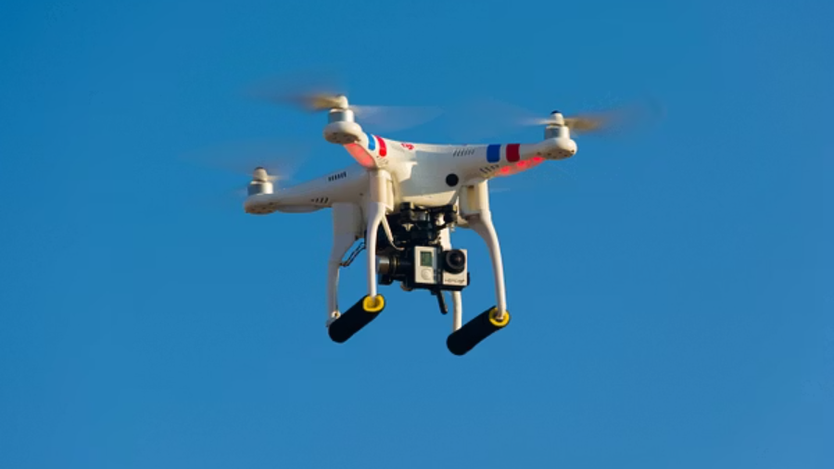
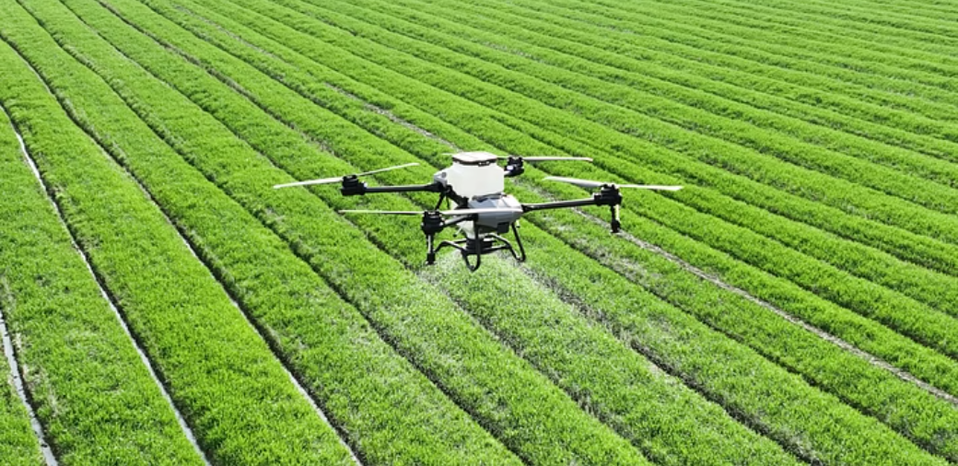
Introduction & Motivation
UAVs (Unmanned Aerial Vehicles) are widely used in agriculture, delivery, surveillance, inspection, and rescue missions.
Recent advances in autonomous control have enabled complex multi-UAV operations.
Cooperative UAVs can share tasks, transport heavier payloads, and improve safety and efficiency.
Photo credits: James Gibson, DRONE EFT & Will Porada on Unsplash
2 / 21
Notes:
“Before going into the problem we worked on, I’ll start with a brief introduction about UAVs and why they are important today. in earlier years UAVs were developed mainly for military and surveillance purposes, but over the years they have evolved and become widely used in civilian applications such as agriculture, inspection, delivery, and search and rescue.” With the progress in control systems, we can now make multiple UAVs work together for tasks like cooperative payload transport. This kind of operation helps carry heavier loads, improves efficiency, and allows work in areas where human access is difficult.

Slide 3
Problem Statement & Motivation
When one UAV in a cooperative transport system fails, the sudden load redistribution creates an immediate and dangerous swinging motion of the payload. Without a specialized control
strategy, these oscillations can escalate, leading to mission failure or collisions.
How to rapidly suppress severe payload oscillations after a UAV failure?
How to maintain coordinated and stable flight among the remaining UAVs?
How to ensure the system can transition back to safe and continue the mission after stabilization?
3 / 32

Slide 4
Objectives & Research Contributions
Objectives of the thesis
• Develop and test algorithms that allow the remaining UAVs to:
• Reconfigure their formation to maintain control of the payload.
• Dampen oscillations rapidly and restore stability through aggressive maneuvers.
• Implement and validate these strategies in simulation like (ROS2/Gazebo and MATLAB)
Main Contribution
Proposed a two-phase control framework for post-failure stabilization and tracking with remaining UAV and payload system.
Introduced a fault-tolerant optimization strategy that enables aggressive stabilization for quick recovery.
Demonstrated through simulations that the approach achieves rapid oscillation damping and trajectory tracking after stabilization.
4 / 32

Slide 5
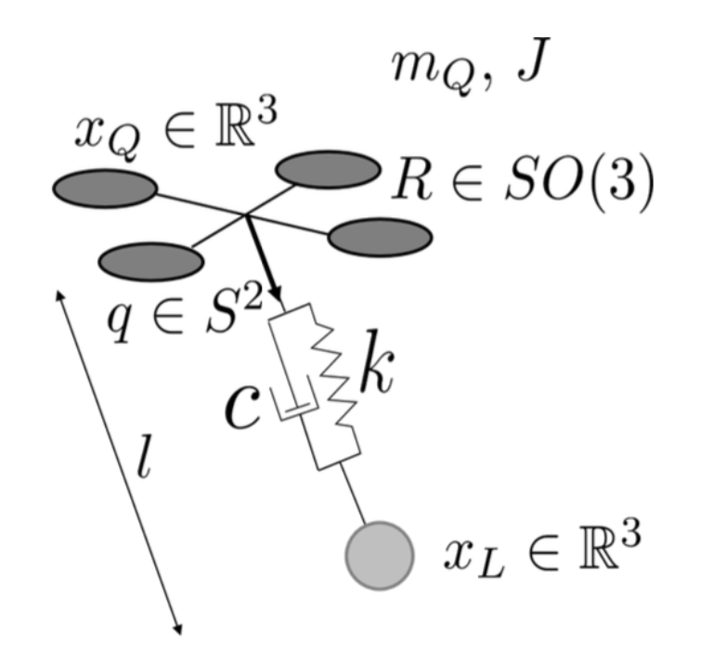
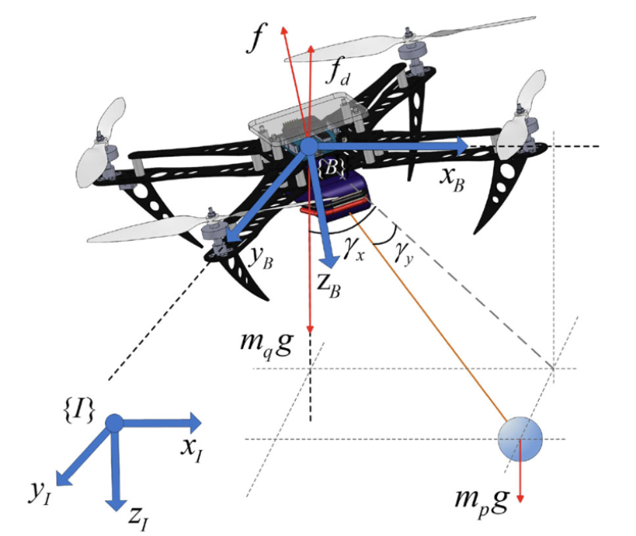
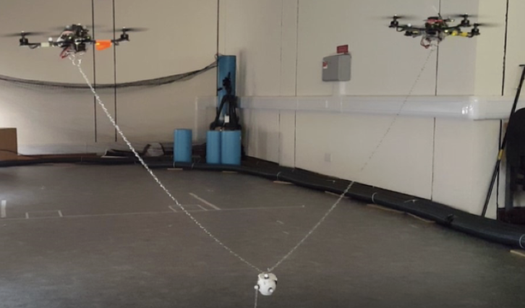
State of the Art
Single-UAV cable-suspended payload system
Elastic cable model for UAV payload system
Multi UAVs payload system
Xian, B., Wang, S. & Yang, S. (2019). Nonlinear adaptive control for an unmanned aerial payload transportation system: theory and experimental validation. Nonlinear Dynamics, 98, 1745–1760
Kotaru, P., Wu, G. & Sreenath, K. (2017). Dynamics and control of a quadrotor with a payload suspended through an elastic cable. In 2017 American Control Conference (ACC), 3906–3913, IEEE.
Alothman, Y.N. (2018). Optimal control of multiple quadrotors for transporting a cable suspended payload.
5 / 32

Slide 6
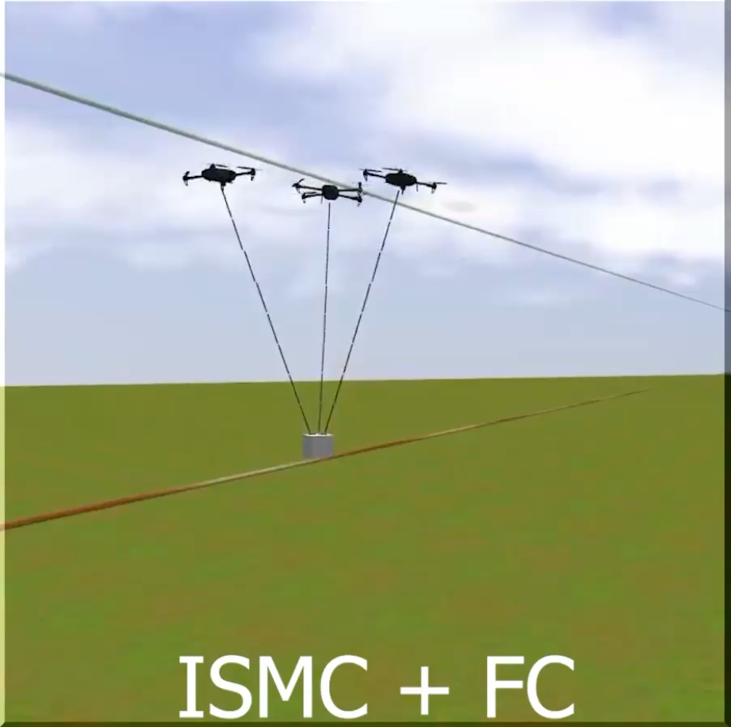
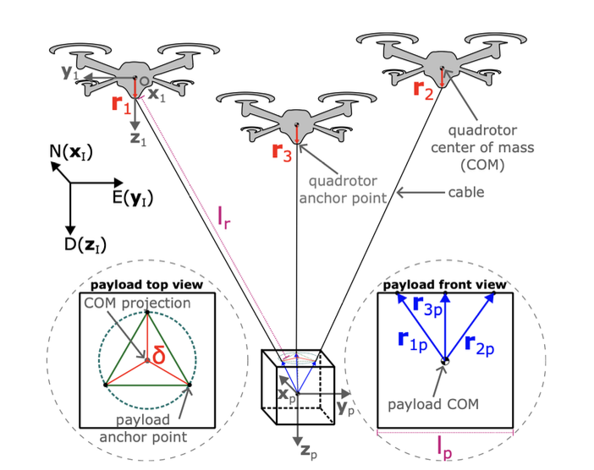
State of the Art
Delbene, A. & Baglietto, M. (2024). Recovery techniques for a multi-uav system transporting a payload. In 2024 IEEE 20th International Conference on Automation Science and Engineering (CASE), 559–566, IEEE.
Delbene, A. & Baglietto, M. (2024). Cables tension modeling for multi-uav payload transportation. In 2024 IEEE 20th International Conference on Automation Science and Engineering (CASE), 212–218, IEEE.
6 / 32

Slide 7
State of the Art
Architectural Similarities to Present Thesis:
➤ Spring-damper cable modeling approach
➤ Fault-tolerant controller
➤ Recovery methodology
➤ Dynamic formulation
Key Differences:
• Anchor points: Off-COM vs. COM-based present thesis.
• Control method: PID + ISMC + CB vs. NMPC optimization
• Recovery strategy: Rule-based vs. Aggressive Stabilization
Delbene, A. & Baglietto, M. (2024). Recovery techniques for a multi-uav system transporting a payload. In 2024 IEEE 20th International Conference on Automation Science and Engineering (CASE), 559–566, IEEE.
Delbene, A. & Baglietto, M. (2024). Cables tension modeling for multi-uav payload transportation. In 2024 IEEE 20th International Conference on Automation Science and Engineering (CASE), 212–218, IEEE.
7 / 32

Slide 8
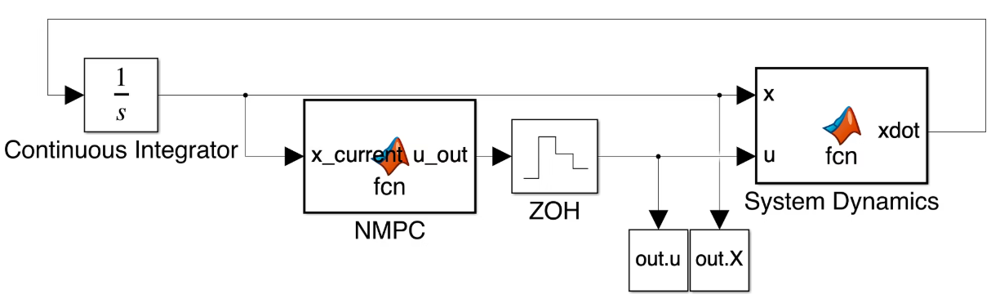
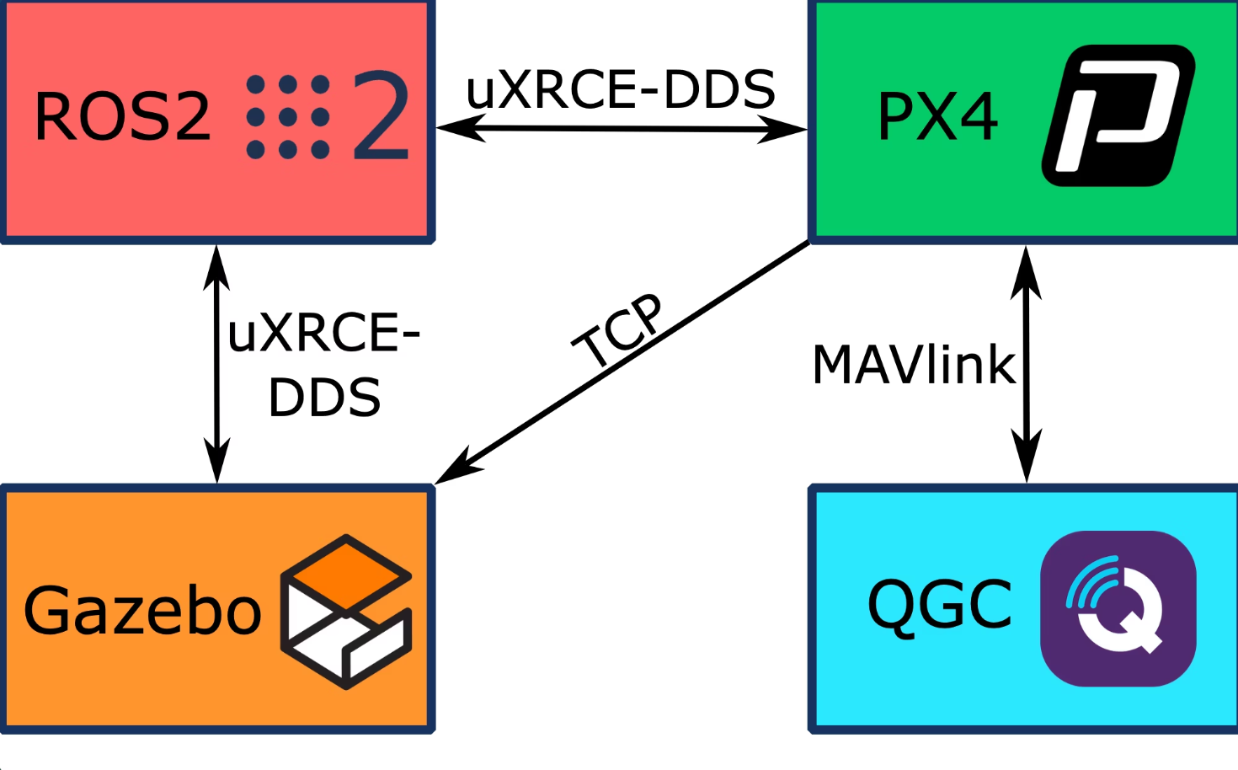
Simulation Setup
Dual-platform setup for prototyping and controller validation
ROS2/Gazebo
MATLAB/Simulink
Rapid NMPC tuning & prototyping
Realistic discrete–continuous system modeling
Fast cost & constraint iteration
Parameter sensitivity analysis
Stability and convergence testing
Transition testing before ROS2 integration
PX4 autopilot integration
ROS2 <--> PX4 communication via XRCE-DDS
QGroundControl monitoring & telemetry
High-fidelity physics simulation in Gazebo
8 / 32

Slide 9
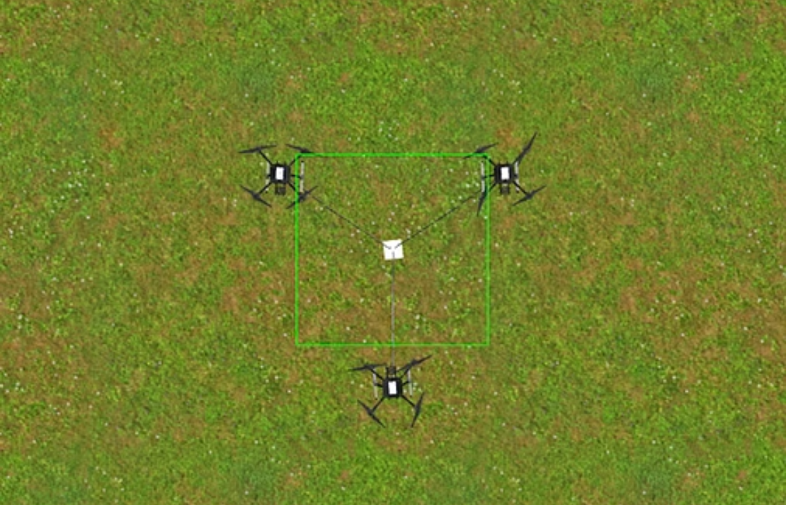
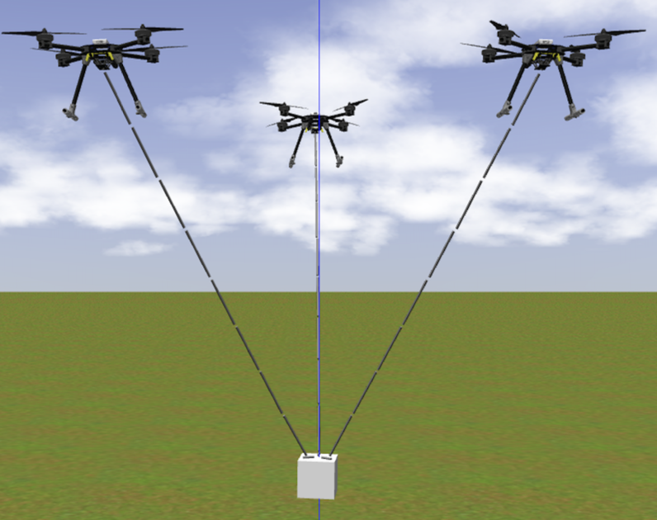
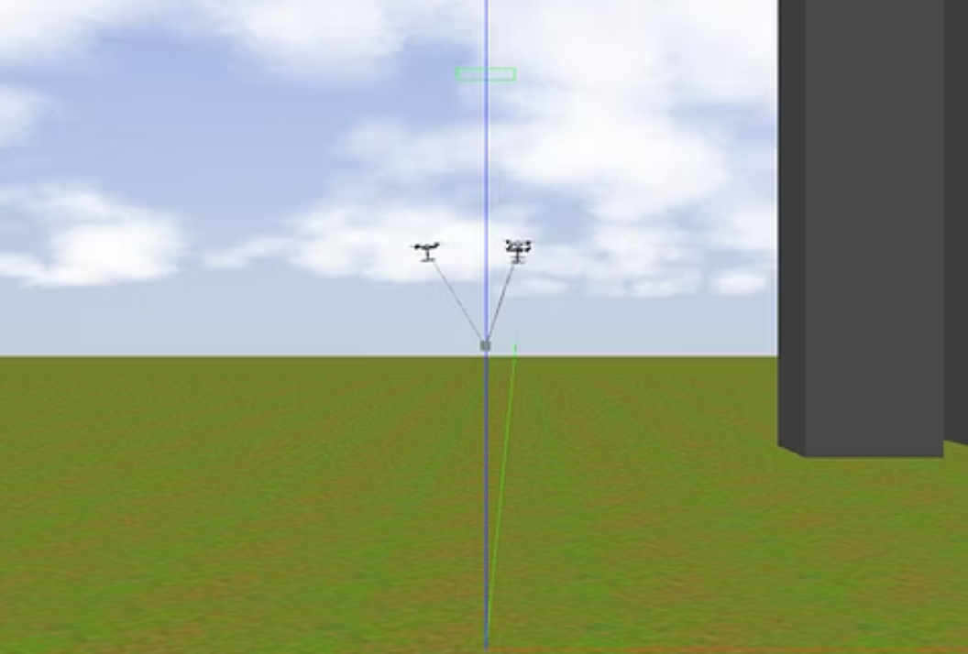
Core Idea behind the Control Approch
Top view
Front view
Side view
9 / 32

Slide 10
Core Idea behind the Control Approch
Top view
Front view
Side view
9 / 32

Slide 11
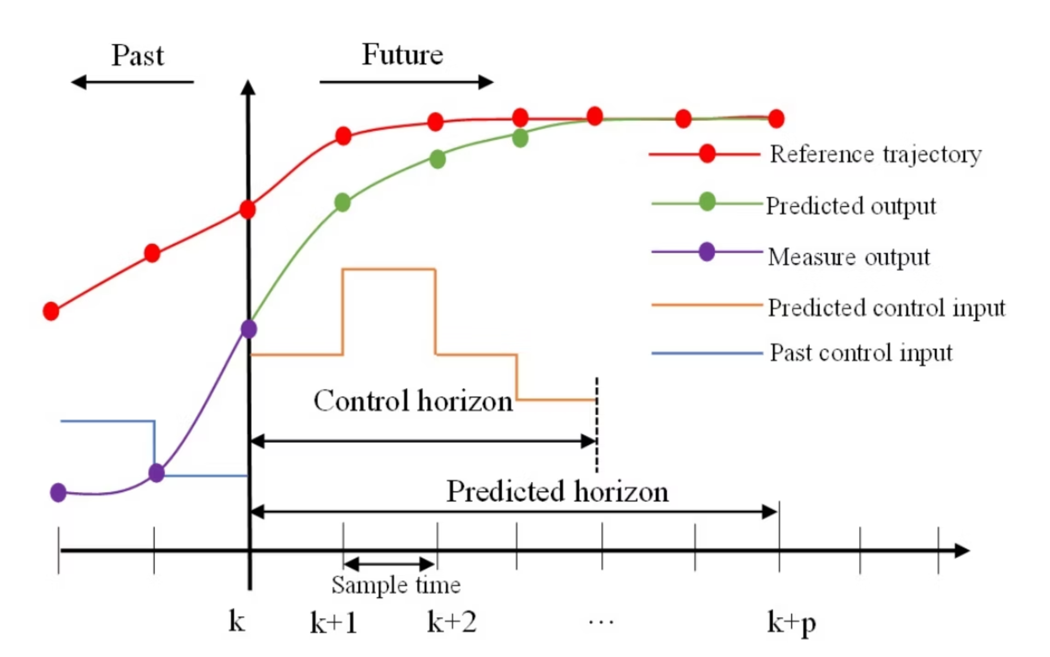
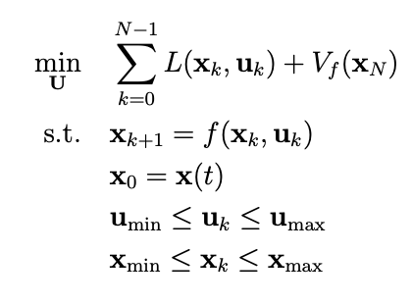
Controller Selection: NMPC
Nonlinear Model Predictive Control (NMPC) is an advanced control strategy that most Extensively Researched Control Framework for UAV Systems which is uniquely suited for this problem.
Why NMPC why not other controllers?
MPC Control Structure
Predictive Nature
Constraint Handling
Robust performance
Multi-Objective Optimization
Natively handles the complex dynamics
Chen, J., Tian, G. & Fu, Y. (2023). A novel multi-objective tuning strategy for model predictive control in trajectory tracking.
Journal of MechanicalScience and Technology, 37, 6657–6667.
NMPC Formulation
10 / 32

Slide 12
Disadvantages of the NMPC?
MPC Control Structure
Chen, J., Tian, G. & Fu, Y. (2023). A novel multi-objective tuning strategy for model predictive control in trajectory tracking.
Journal of MechanicalScience and Technology, 37, 6657–6667.
NMPC Formulation
11 / 32

Slide 13
Disadvantages of the NMPC?
MPC Control Structure
1. Model Sensitivity
Chen, J., Tian, G. & Fu, Y. (2023). A novel multi-objective tuning strategy for model predictive control in trajectory tracking.
Journal of MechanicalScience and Technology, 37, 6657–6667.
NMPC Formulation
12 / 32

Slide 14
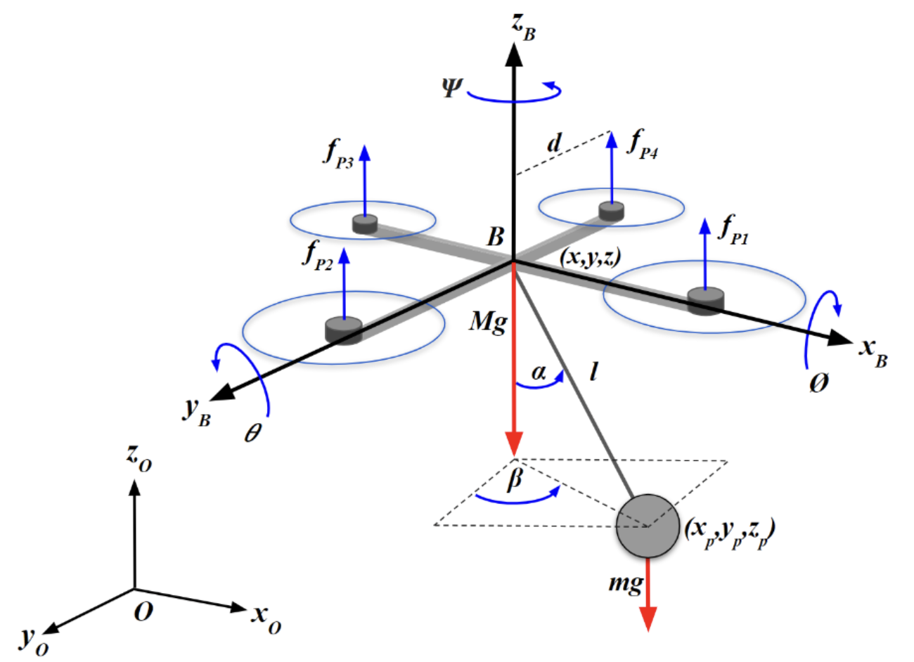
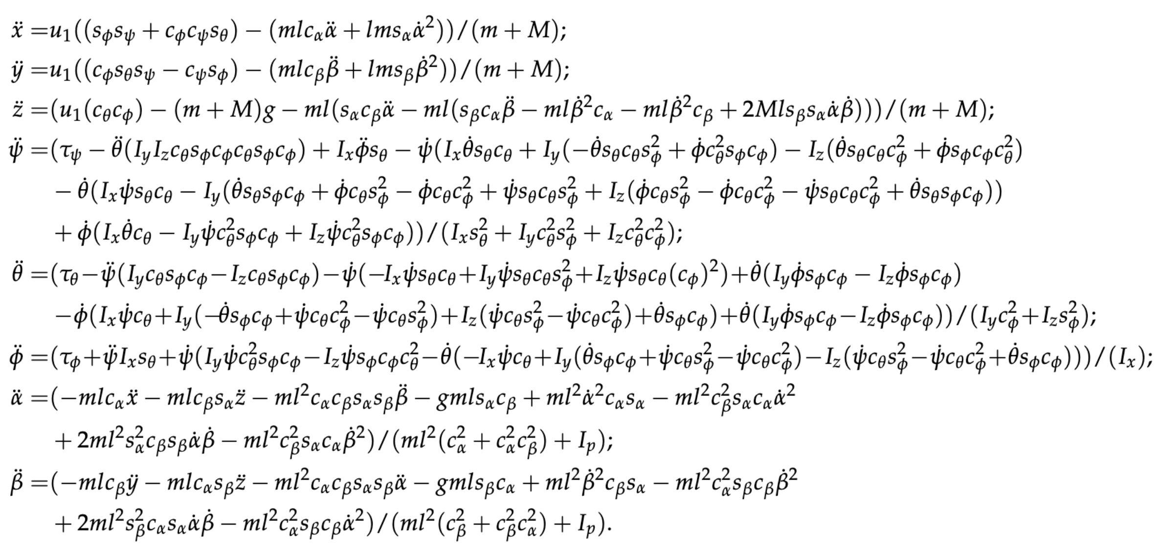
Mathematical Model
The effectiveness of the NMPC controller heavily relies on an accurate mathematical model.
Quadrotor with a cable-suspended payload
Urbina-Brito, N., Guerrero-Sánchez, M.E., Valencia-Palomo, G., Hernández-González, O., López-Estrada, F.R., & Hoyo-Montaño, J.A. (2021). A predictive control strategy for aerial payload transport using an unmanned aerial vehicle. Mathematics, 9, 1822.
13 / 32

Slide 15
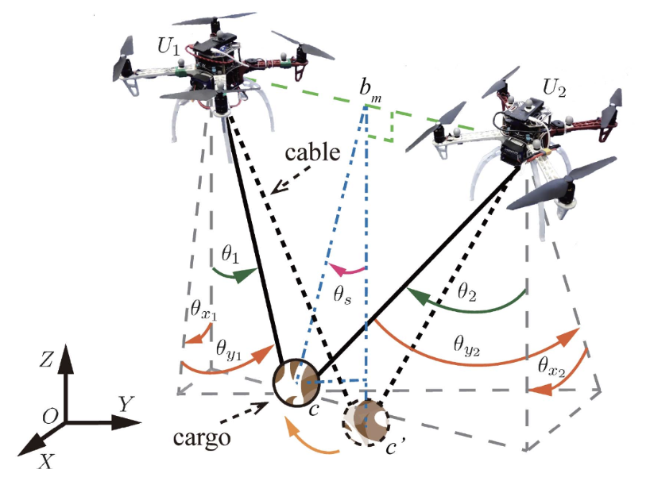
Mathematical Model
The effectiveness of the NMPC controller heavily relies on an accurate mathematical model.
Multi-UAV cooperative payload transport system
Liang, X., Zhang, Z., Yu, H., Wang, Y., Fang, Y. & Han, J. (2022). Antiswing control for aerial transportation of the suspended cargo by dual quadrotor uavs. IEEE/ASME Transactions on Mechatronics, 27, 5159–5172.
14 / 32

Slide 16
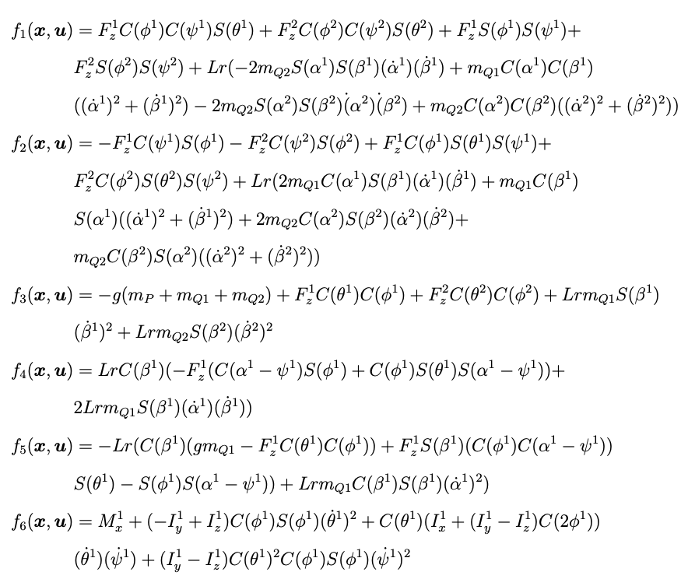
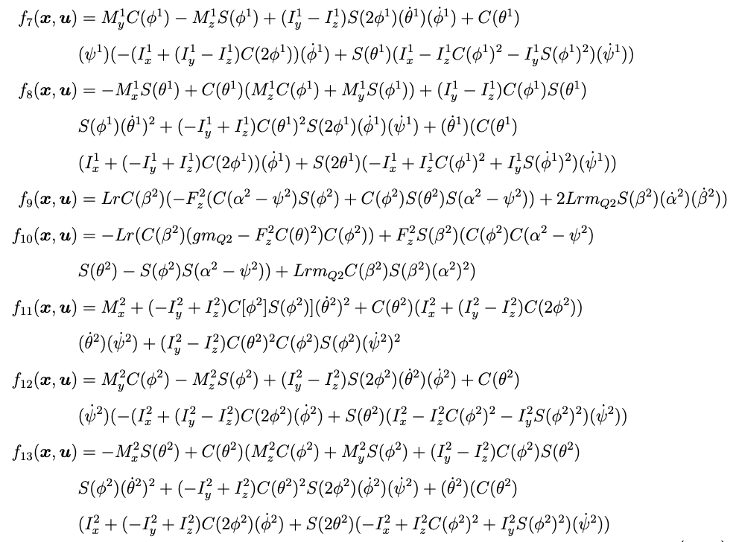
Mathematical Model
The effectiveness of the NMPC controller heavily relies on an accurate mathematical model.
Alothman, Y. & Gu, D. (2018). Using constrained nmpc to control a cable-suspended payload with two quadrotors. In 2018 24th International Conference on Automation and Computing, 1–6, IEEE.
Alothman, Y.N. (2018). Optimal control of multiple quadrotors for transporting a cable suspended payload.
15 / 32

Slide 17
Mathematical Model
The effectiveness of the NMPC controller heavily relies on an accurate mathematical model.
Alothman, Y. & Gu, D. (2018). Using constrained nmpc to control a cable-suspended payload with two quadrotors. In 2018 24th International Conference on Automation and Computing, 1–6, IEEE.
Alothman, Y.N. (2018). Optimal control of multiple quadrotors for transporting a cable suspended payload.
15 / 32

Slide 18
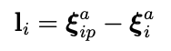
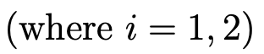
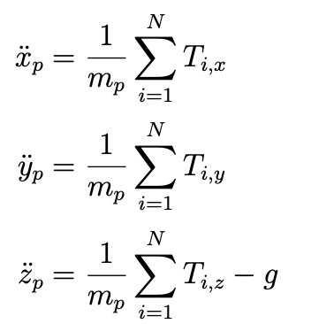
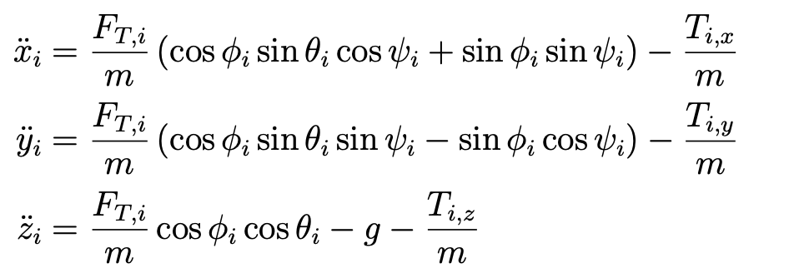
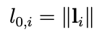
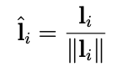
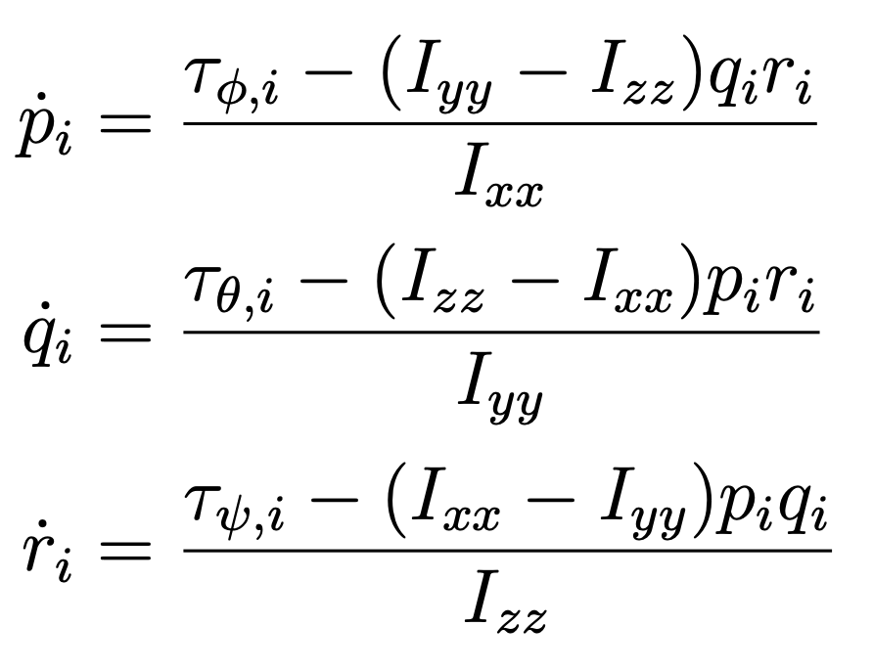
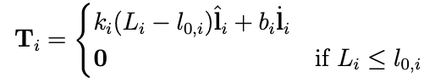
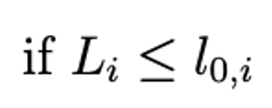

Mathematical Model
The effectiveness of the NMPC controller heavily relies on an accurate mathematical model.
Cable Tension Modeling
Quadrotor Dynamics
Payload Dynamics
Quadrotor Translational Dynamics:
Payload Translational Dynamics:
Quadrotor Rotational Dynamics:
Delbene, A. & Baglietto, M. (2024). Recovery techniques for a multi-uav system transporting a payload. In 2024 IEEE 20th International Conference on Automation Science and Engineering (CASE), 559–566, IEEE.
16 / 32

Slide 19
Disadvantages of the NMPC?
MPC Control Structure
MODEL SENSITIVITY
COMPUTATIONAL RESOURCES
Chen, J., Tian, G. & Fu, Y. (2023). A novel multi-objective tuning strategy for model predictive control in trajectory tracking.
Journal of MechanicalScience and Technology, 37, 6657–6667.
NMPC Formulation
17 / 32

Slide 20
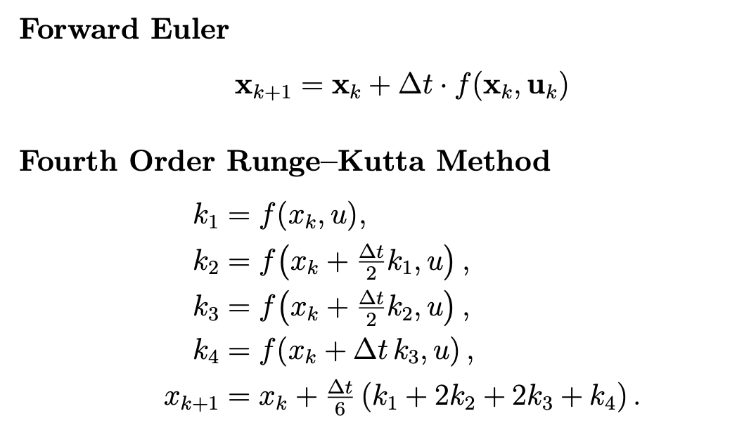

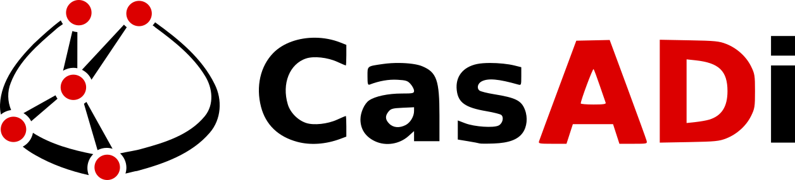
NMPC Implementation Setup
Optimization Framework
Discretization Method
Several toolchains are used in real-time NMPC reseach: CasAdi, ACADO, Forces Pro, FiMCON etc.
We selected CasADi because it provides:
Easy Prototyping
Large and active community support
Programming interface Python / MATLAB / C++
Enables real-time NMPC computation
Trade-off: RK4 provides higher accuracy but 4 times higher computational cost. While Euler is faster, easier to implement, and provides sufficient accuracy.
Workineh, Y., Mekonnen, H., & Belete, B. (2024). Numerical methods for solving second-order initial value problems of ordinary differential equations using Euler and fourth-order Runge–Kutta methods. Frontiers in Applied Mathematics and Statistics, 10.
Andersson, J.A.E., Gillis, J., Horn, G., Rawlings, J.B., & Diehl, M. (2018). CasADi: a software framework for nonlinear optimization and optimal control. Mathematical Programming Computation
18 / 32

Slide 21
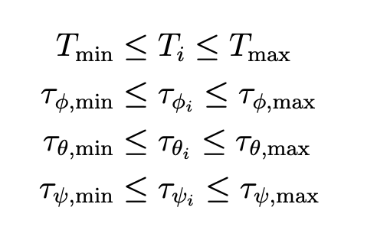
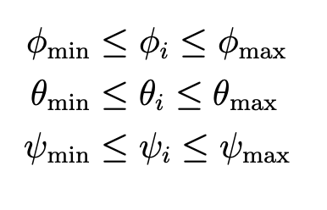
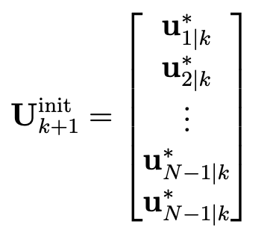
NMPC Configuration & Parameters
Parameter values were optimized through iterative simulation and experimental validation.
Prediction Horizon
Control Horizon (Nc)
Sampling / Discretization Time (Δt)
Constraint violation tolerance
Maximum solver iterations
Maximum step tolerance
Input constraint tolerance
Control Input Constraints
State Constraints
Warm Starter Formulation
19 / 32

Slide 22
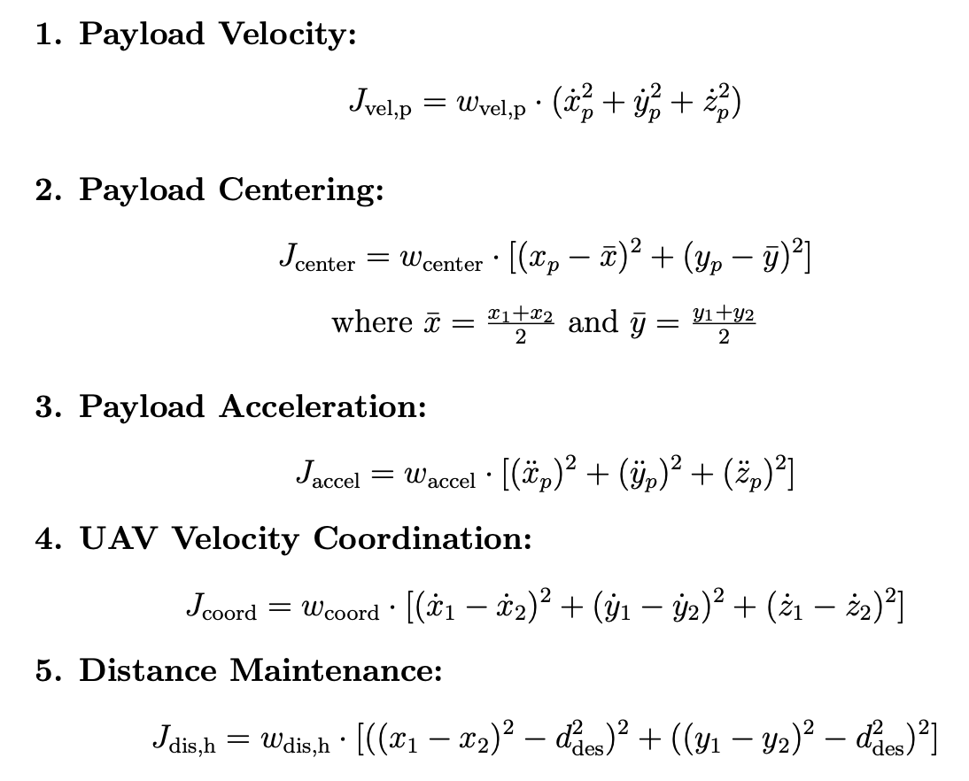
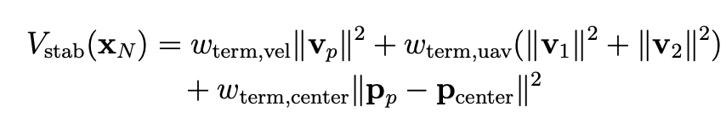
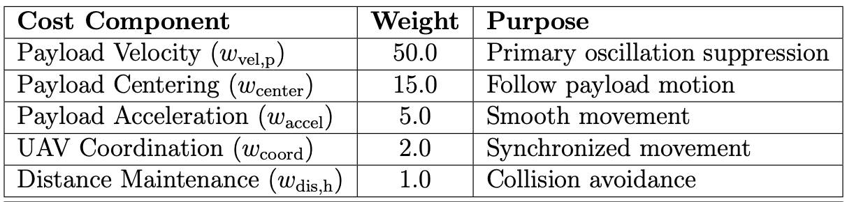
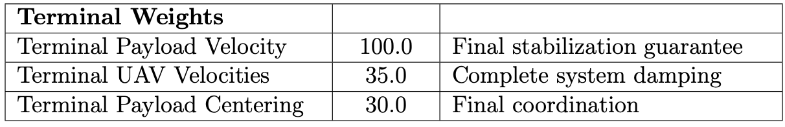
Phase 1: Aggressive Stabilization
Terminal cost:
20 / 32

Slide 23
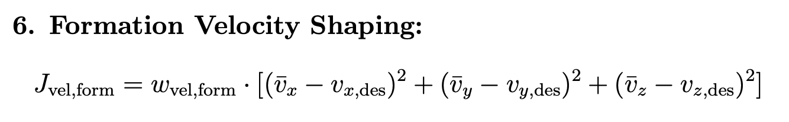
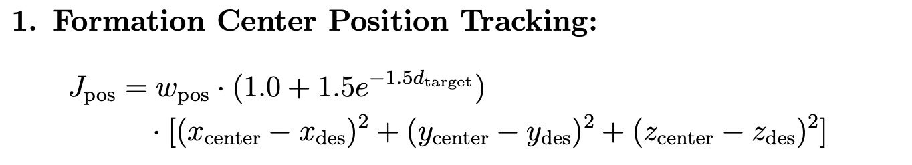
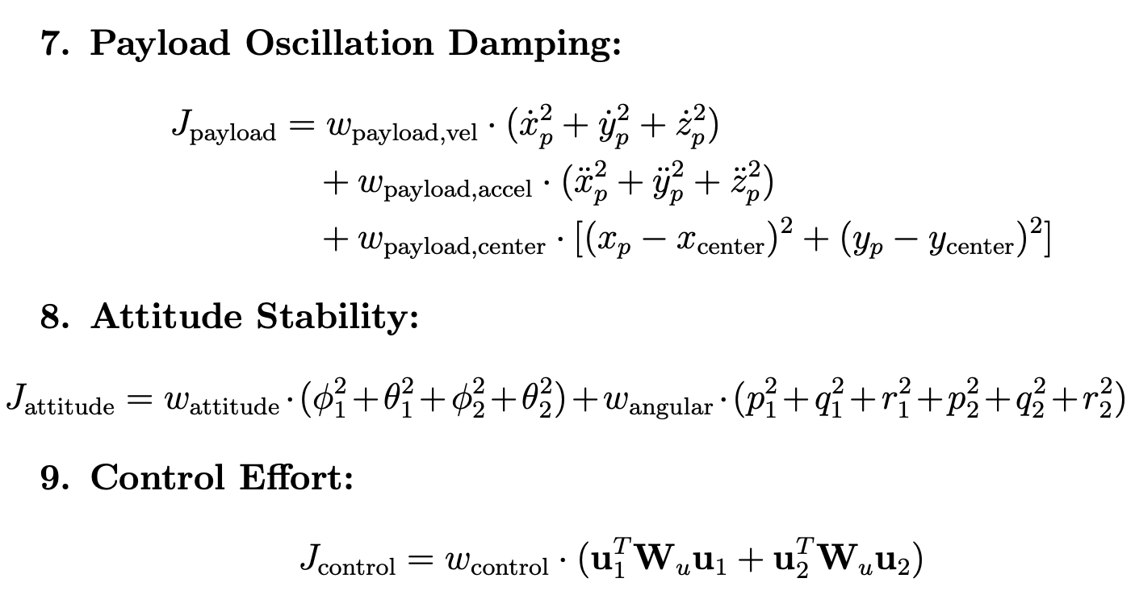
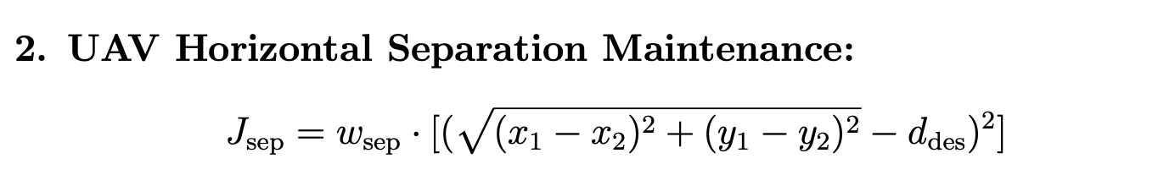
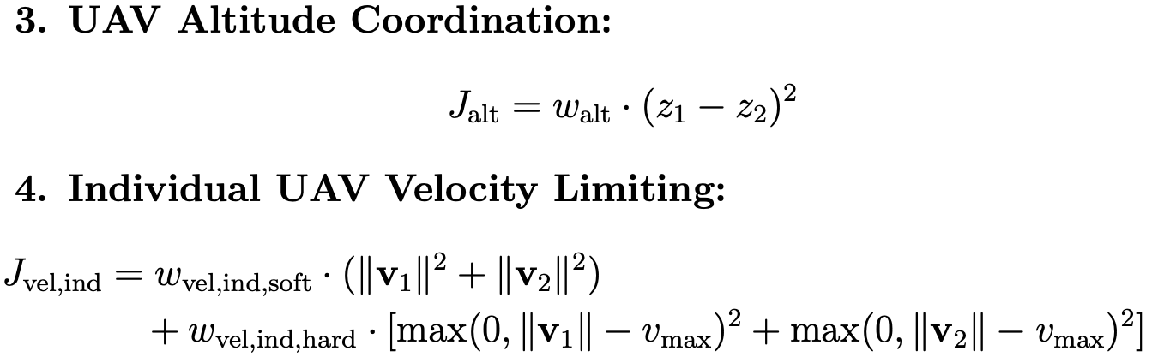
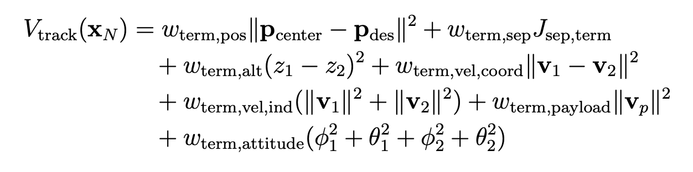
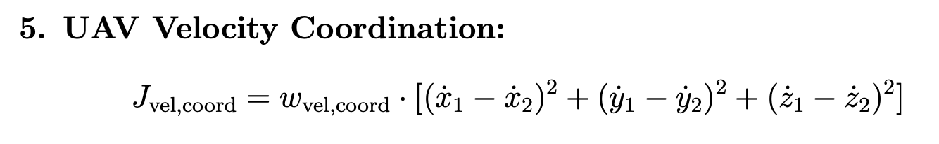
Phase 2: Precision Tracking
Terminal cost:
21 / 32

Slide 24
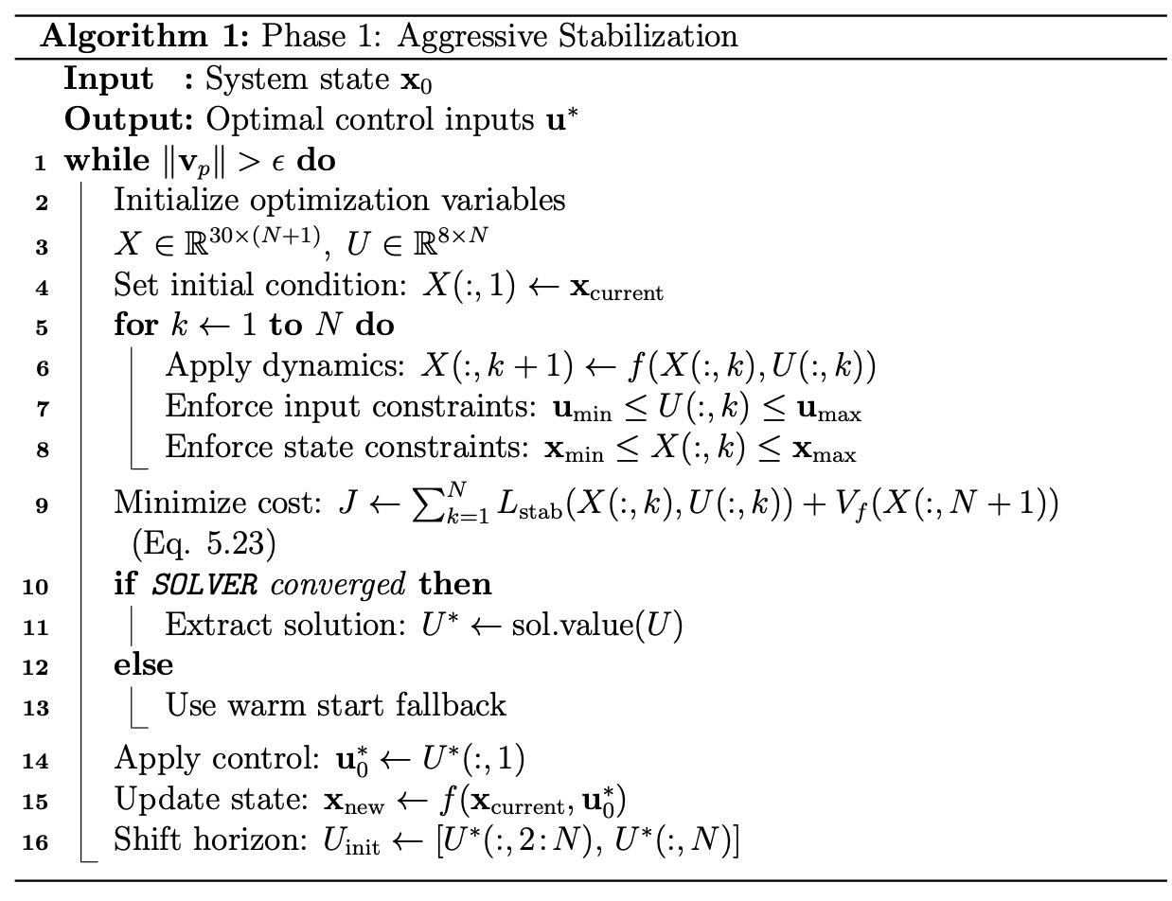
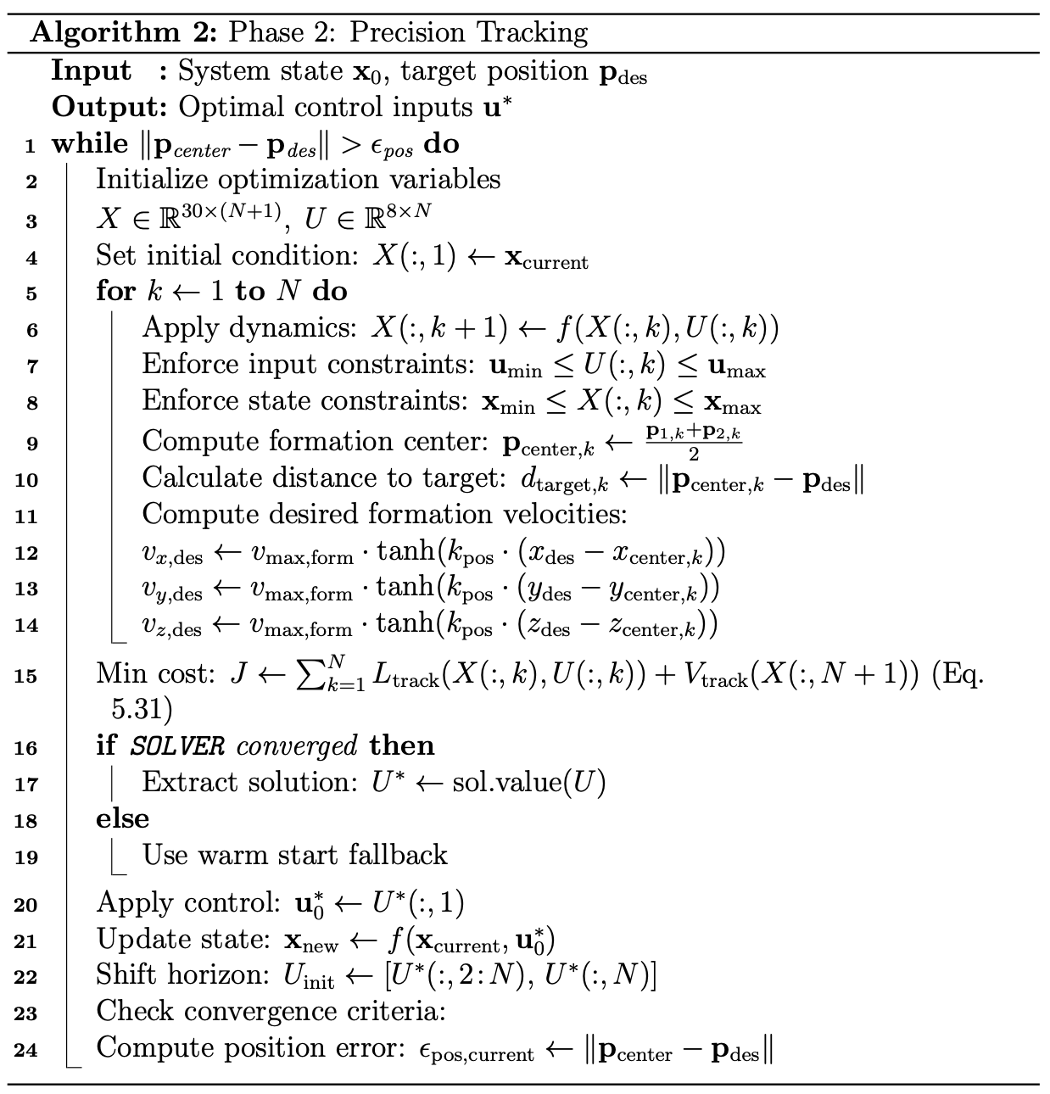
The Two-Phase NMPC Strategy
A single controller is not optimal for both emergency recovery and normal flight. We developed a two-phase strategy that switches the NMPC’s objective (cost function) based on the system’s stability.
Phase 1: Aggressive Stabilization
Phase 2: Precision Tracking
Phase Switching Logic
The controller transitions from Phase 1 to Phase 2 when the payload and UAV velocities fall below a predefined threshold (e.g., < 0.05 m/s), indicating the system is stable.
22 / 32

Slide 25
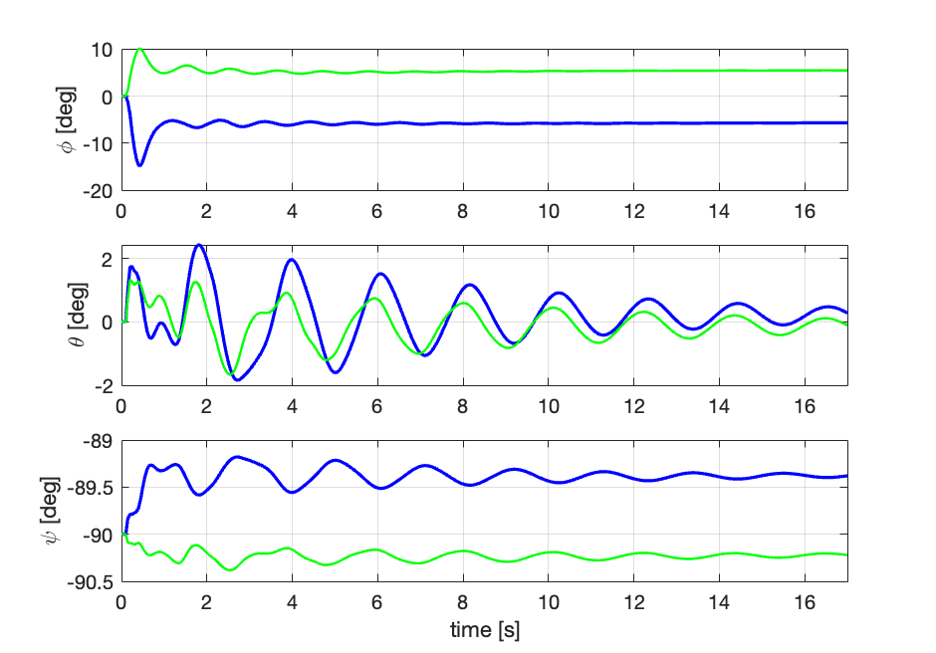





Results: Scenario 1 – Tracking without Stabilization
Altitude
23 / 32

Slide 26






Results: Scenario 2 – Stabilization then Tracking
Altitude
24 / 32

Slide 27

Conclusion
We successfully developed and validated a two-phase NMPC framework for fault-tolerant control of a multi-UAV payload system.
The dedicated aggressive stabilization phase is proven to be critical for safety, rapidly suppressing dangerous post-failure oscillations.
The framework demonstrates a seamless transition to a precision tracking phase, allowing the mission to continue after recovery.
Unfortunately, due to a communication error/bug between ROS2 and PX4, we were not able to fully test the controller performance in the Gazebo simulation. However, this limitation was related to the ROS interface, not the proposed NMPC algorithm itself.
25 / 32

Slide 28

Future Work
Finalize ROS2/Gazebo Integration
Enhanced Simulation Testing
Advanced NMPC Methodologies
Laboratory Experimental
Onboard Implementation
26 / 32

Slide 29
Selected References
A. Delbene and M. Baglietto, “Cables tension modeling for multi-UAV payload transportation,” Proc. 2024 IEEE 20th Int. Conf. on Automation Science and Engineering (CASE), pp. 212–218, IEEE, 2024.
2. A. Delbene and M. Baglietto, “Recovery techniques for a multi-UAV system transporting a payload,” Proc. 2024 IEEE 20th Int. Conf. on Automation Science and Engineering (CASE), pp. 559–566, IEEE, 2024.
3. Y. Alothman and D. Gu, “Using constrained model predictive control to control two quadrotors transporting a cable-suspended payload,” Proc. 2018 13th World Congress on Intelligent Control and Automation (WCICA), pp. 228–233, IEEE, 2018.
4. P. Kotaru, G. Wu, and K. Sreenath, “Dynamics and control of a quadrotor with a payload suspended through an elastic cable,” Proc. 2017 American Control Conference (ACC), pp. 3906–3913, IEEE, 2017.
5. G. Li and G. Loianno, “Nonlinear model predictive control for cooperative transportation and manipulation of cable-suspended payloads with multiple quadrotors,” Proc. 2023 IEEE/RSJ Int. Conf. on Intelligent Robots and Systems (IROS), pp. 5034–5041, IEEE, 2023.
27 / 32

Slide 30

Acknowledgements
I would like to express my sincere gratitude to my supervisors, Prof. Marco Baglietto, Prof. Olivier Kermorgant, and Dr. Andrea Delbene, for their invaluable guidance and support throughout this thesis.
I would like to extend thanks to Prof. Carmine Recchiuto for providing the computing resources essential to completing this thesis.
My thanks also go to the EMARO team at École Centrale de Nantes, the University of Genova, and the GRAAL laboratory for providing the environment and resources that made this research possible.
Special thanks to my family for their unconditional love and encouragement.
28 / 32

Slide 31
Thank You !!
Thank you for attending this thesis defense.
Your presence and engagement are greatly appreciated.
Presented by: ALVIN ISAC PREMSUNDER
Student ID: s7789223
Email: alvinisac3399@gmail.com |
alvin-isac.prem-sunder@eleves.ec-nantes.fr
Questions are welcome

